Slide 1
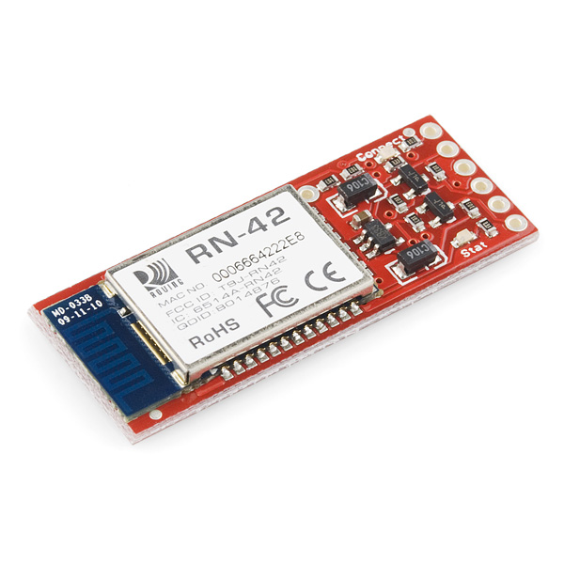

COMMUNICATION

Slide 2
~ Serial Connection with BlueTooth
~ ASCII text messages sent as insctructions

Slide 3
~ Very robust link both in integrity and transmission distance (18m)
~ Hardy frequency hopping scheme - operates in harsh RF environments like WiFi, 802.11g, and Zigbee
~ Encrypted connection
~ Frequency: 2.4~2.524 GHz
~ Operating Voltage: 3.3V-6V
~ Serial communications: 2400-115200bps
~ 14400Bps
Built-in antenna

Slide 4
POWER TETHER

Slide 5

Power
~ Provides power over ethernet
~ Maximum wattage is 36 Watts
~Category 5 cable

